Slide 1
Super computer

Slide 2
Presanted by:-
1.Gupta Monti (Roll no-09)
2.Patel Trusha (Roll no-34)
3.Raval Nisha (Roll no-56)
4.Rathod Zalak (Roll no-55)
Group no:11
Guided By:-
Asst.prof.Selvina Doshi

Slide 3
Super computer:-
Defination:-
They are used for complror scientific computations are known as super computer.
Description:-
Very large size and very high speeds characterize them.The word length for these computer is more than 64 bits.

Slide 4
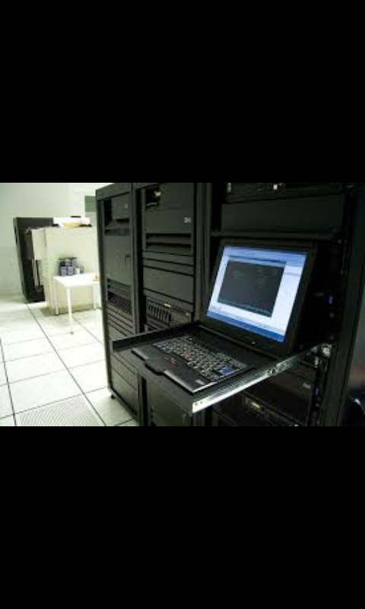
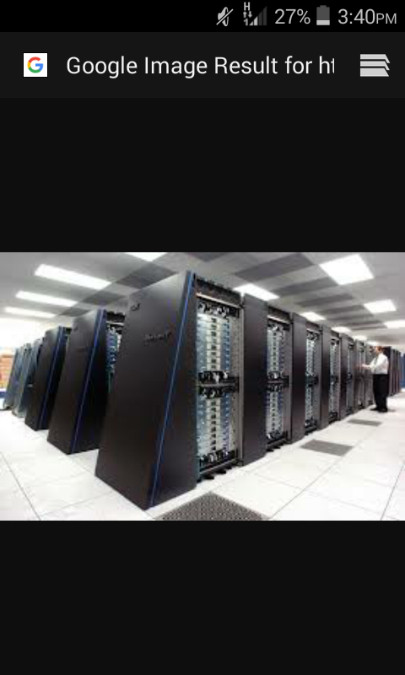
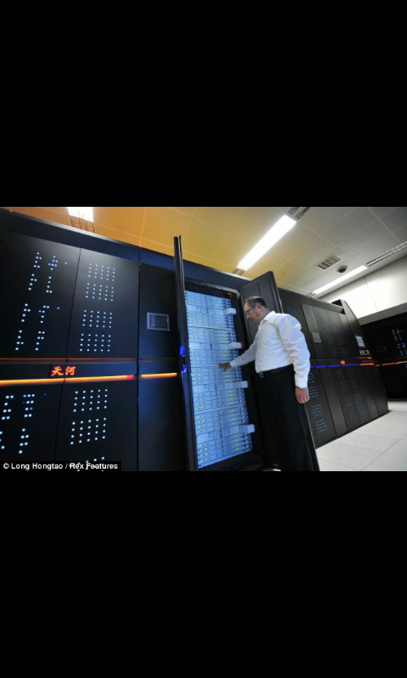

Slide 5
Example:-
CRAY 1/2/3,
PARAM 10000,
GARUDA etc….
Application:-
They are used in weather forecasting in nuclear power plants in defense ,in medical ,in electronic design ,in energy management etc….

Slide 6
Feature:-
1.More than one processing unit
2.perform parallel processing
3.Very high processing speed and large in size.

Slide 7
thank you

